Slide 1
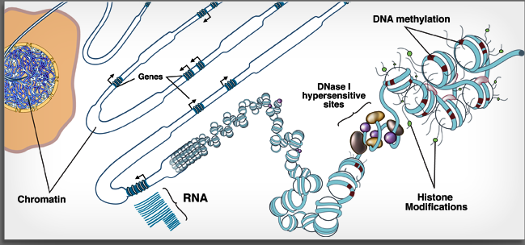
(just some of the) Applications of High Throughput Sequencing
Image credit: NIH Epigenome Roadmap Consortium (http://www.roadmapepigenomics.org/)
Bioinformatics Bootcamp 2017
9-26-17
David Gorkin, PhD
Associate Director of Epigenomics
UCSD Center for Epigenomics
dgorkin@ucsd.edu

Slide 3
Outline & objectives for today
Overview of High Throughput Sequencing (HTS) technology
Intro to the human genome and gene regulation
Common applications of HTS
Learning objectives: (you should be able to…)
Describe some widely used HTS-based methods
Compare and contrast these HTS-based methods
Identify scenarios in which you want to apply one technology vs another

Slide 4
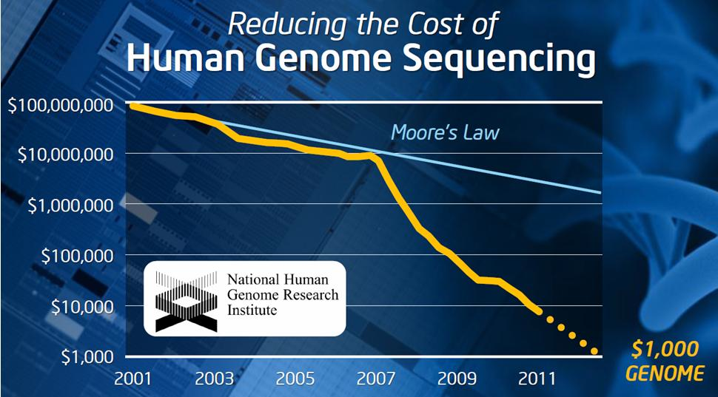
HTS: Engine fueling biomedical research

Slide 5
How does HTS work? (part 1/3)
Illumina
(sequencing by synthesis )
*Pacific Biosciences (PacBio)
*Oxford nanopore
Ion Torrent
454 pyrosequencing
SOLiD
Good review: PMID 27184599
Add sequencing reagents (polymerase, labelled nucleotides)
First base incorporated
Wash out unincorporated bases
Detect signal
Remove terminator in preparation for next cycle
One “cycle”

Slide 6
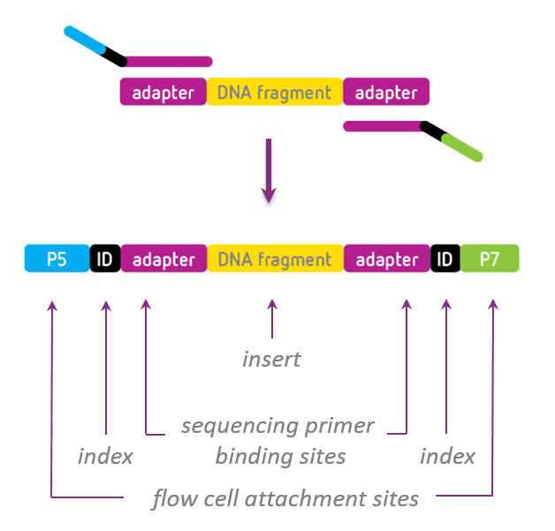

How does HTS work? (part 2/3)

Slide 7
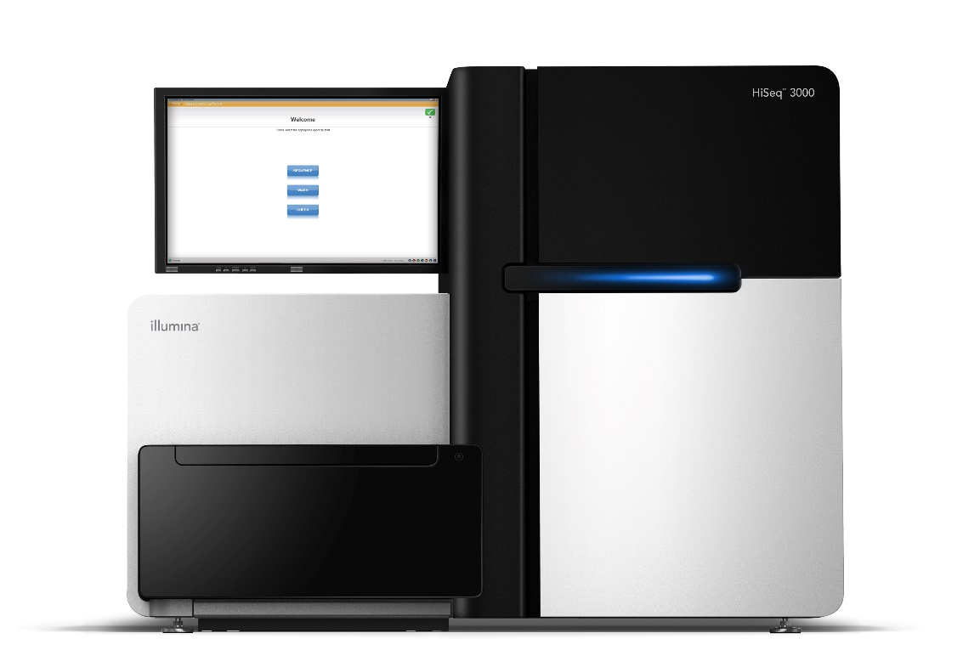
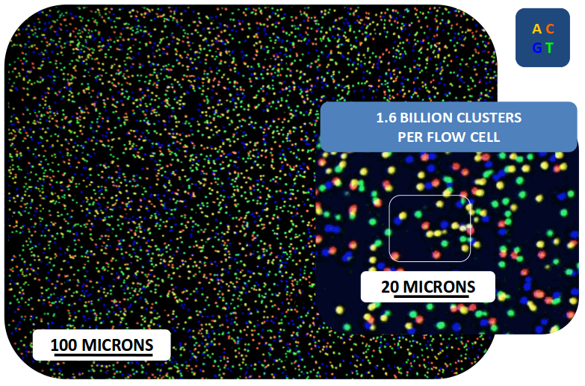
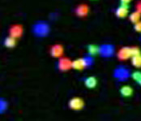
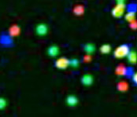
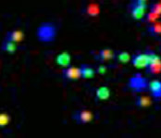
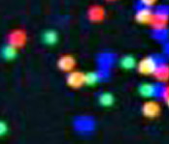
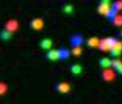

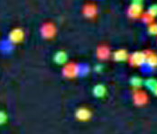
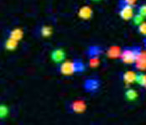

How does HTS work? (part 3/3)
T G C T A C G A T …
1
2
3
4
5
6
7
8
9
T T T T T T T G T …

Slide 8
Typical output of HTS (depends on instrument, run type)
Lots of sequencing reads!
~20M – 500M+ reads per lane
1-8 lanes per flow cell
Short sequencing reads
36 – 300 bp (depending on instrument, run type)
May be “paired-end”
You will generally receive these reads in the format of a fastq file
more on this later in the course

Slide 9
Outline & objectives for today
Overview of High Throughput Sequencing (HTS) technology
Intro to the human genome and gene regulation
Common applications of HTS
Learning objectives: (you should be able to…)
Describe some widely used HTS-based methods
Compare and contrast these HTS-based methods
Identify scenarios in which you want to apply one technology vs another

Slide 10
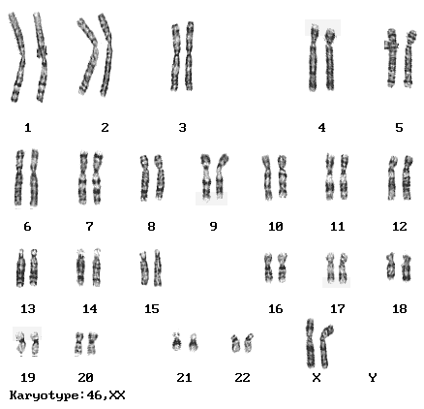
A bit more about the human genome
How many chromosomes?
How many base pairs?
How variable between individuals?
How many protein-coding genes?
What fraction of those base pairs are protein coding sequence?
23 (haploid)
~3 billion (haploid)
~3 million SNVs between any two individuals (~0.1% diff)
Also Structural Variants (SVs)
~20,000 (another 20K+ RNA genes)
< 2%!
SNV = single nucleotide variant

Slide 11
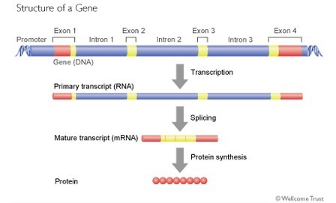
Coding sequence in our genome
What about the rest of the genome?
(non-coding portion)
Non-coding RNA genes
Repetitive sequences (~50%!)
Regulatory sequences
Other…
Avg gene length ~30Kb
(highly variable)
Avg mRNA length ~3Kb
(highly variable)

Slide 12
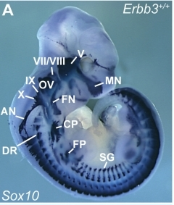
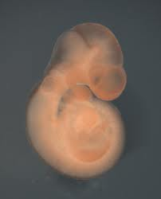
cis-regulatory sequences
Basal Transcriptional
Machinery
Normal Sox10 expression
Expression from promoter alone
Expression from promoter + enhacner
Promoter
mRNA
P
Enhancer
E
P
Silencer/repressor
P
P
LacZ
E
P
LacZ
S
Sox10
promoter
reporter gene
Sox10
enhancer #4
Insulator/boundary
GENE B
P
I
E
P
GENE A
Key:
P
Promoter
S
Silencer
E
Enhancer
I
Insulator
Visel et al., Nature. 2009

Slide 13
A (over-simplified) model for gene regulation
Visel et al., Nature. 2009

Slide 14
Molecular properties of cis-regulatory sequences
En
Pr
Gene X
Co-factors (p300, Mediator, Cohesin)
Basal transcriptional machinery
(RNA Pol2)
TF
TF
TF
TF
GTF
GTF
Enhancer
Promoter
N
N
N
N
N
N
N
N
N
Binds TFs and co-factors
Nucleosome-free region of “accessible” chromatin
Lack of DNA methylation
Adjacent nucleosomes enriched for H3K4me1 & H3K27ac
Binds RNA Pol II, TFs and co-factors
Nucleosome-free region of “accessible” chromatin
Lack of DNA methylation
Adjacent nucleosomes enriched for H3K4me3 & H3K27ac
→ These are all things we can measure with HTS-based methods!
Example histone mod nomenclature: H3K4me3
H3 = Histone 3
K4 = Lysine 4
me3 = tri-methylation
Visel et al., Nature. 2009

Slide 15
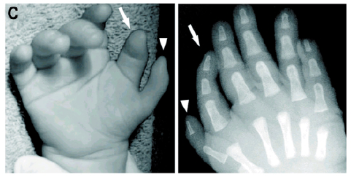
Cis-regulatory elements & human disease
1) Isolated cases of highly penetrant mutations in regulatory elements.
Polydactyly [SHH] (Lettice et al., 2002)
β-thalassemia [HBB] (Driscoll et al., 1989)
Pierre Robin Sequence [SOX9] (Benko et al., 2009)
Pancreatic Agenesis [PTF1A] (Weeden et al., 2014)
Congenital Heart Defect [TBX5] (Smemo et al., 2012)
Cancer[TERT] (Huang et al., 2013)
Lettice et al., 2003; Sagai et al., 2005
2) SNPs associated with human disease by GWAS are highly enriched in enhancers.
Cleft lip [IRF6] (Rahimov et al., 2008)
Obesity/T2D [IRX3] (Smemo et al., 2014)
Hirschsprung's disease [RET] (Emison et al., 2005)
Long QT syndrome [NOS1AP] (Kapoor et al., 2014)
Pigmentation & melanoma [IRF4] (Praetorius et al., 2013)
Maurano et al. Science. 2012.
For precision medicine we will need to better interpret non-coding genetic variation (98% of the human genome is non-coding)

Slide 16
Outline & objectives for today
Overview of High Throughput Sequencing (HTS) technology
Intro to the human genome and gene regulation
Common applications of HTS
Learning objectives: (you should be able to…)
Describe some widely used HTS-based methods
Compare and contrast these HTS-based methods
Identify scenarios in which you want to apply one technology vs another

Slide 17
Whole genome sequencing, of course
Genome from cells, tissue
Break/cut into small fragments
Sequence billions of fragments
Map (or assemble)
into contiguous sequence

Slide 18
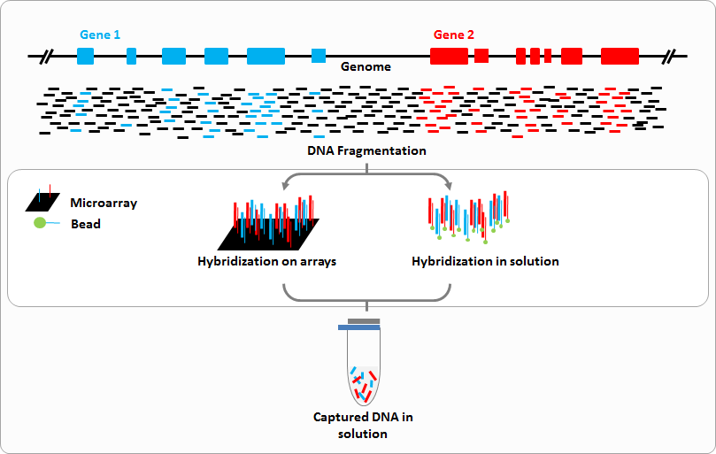
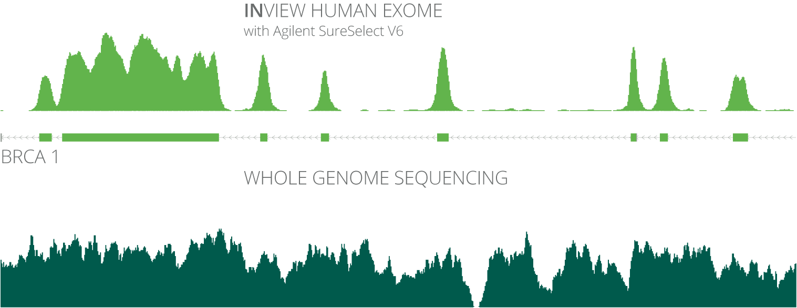
Exome sequencing
→Target enrichment before sequencing

Slide 19
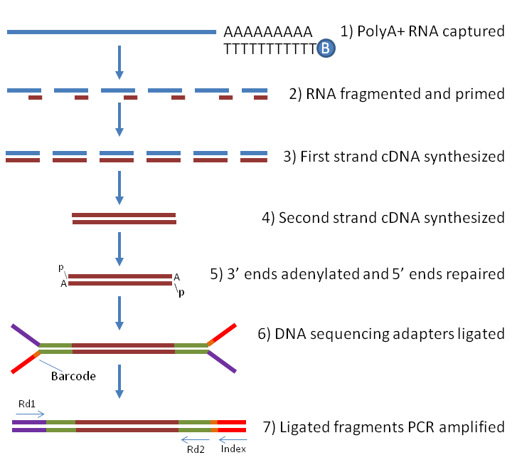
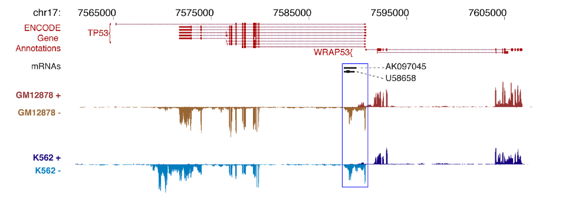
RNA-seq: studying transcribed portions of the genome
Many variations
Total RNA
PolyA selection (mRNA)
rRNA depletion
Small RNA selection
microRNA, snRNA, etc
FPM (Fragments per million)

Slide 20
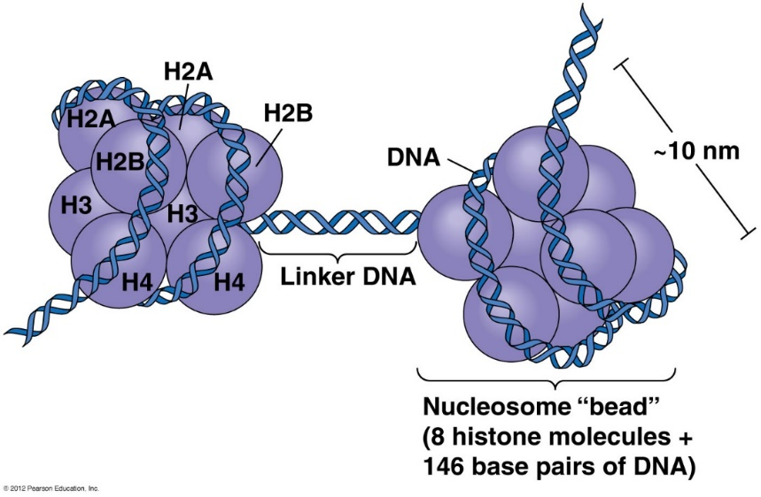
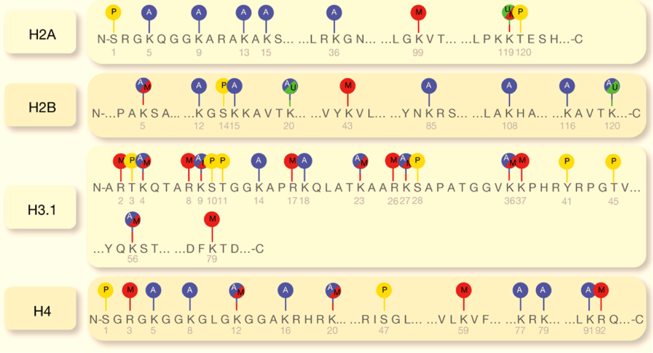
ChIP-seq: studying protein binding to the genome
ChIP = Chromatin Immunoprecipitation
Co-factors (p300, Mediator, Cohesin)
TF
TF
TF
Enhancer
N
N
N
N
N
N
Kim, 2014. PMID: 24926467
En
Pr
Gene X
Active:
H3K4me1,
H3K27ac
H3K4me3,
H3K27ac
H3K36me3
Poised:
H3K4me1
H3K4me3
-
Repressed:
H3K27me3
(H3K9me3)
H3K27me3
(H3K9me3)
H3K27me3
(H3K9me3)
Inactive:
-
(H3K4me3)
-
→ Very useful for genome annotation
M=methylation, P=phosphorylation, A=acetylation, U=ubiquitylation
(also sumoylation, citrulination, others)

Slide 21
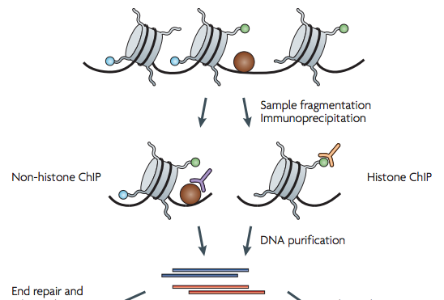
ChIP-seq: studying protein binding to the genome
ChIP = Chromatin Immunoprecipitation
Fold enrichment over “input”
Sequencing
Image credit: http://informatics.fas.harvard.edu
Valouev et al., 2008. PMID: 19160518

Slide 22
ChIP-seq: An example of real data
Fold enrichment over “input”

Slide 23
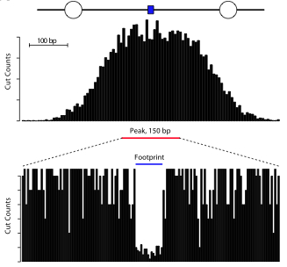
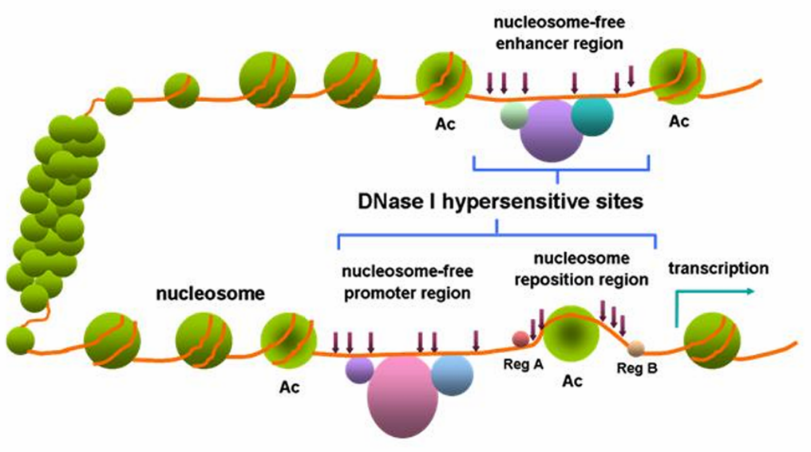
Studying “open” chromatin (DNase-seq, ATAC-seq)
Co-factors (p300, Mediator, Cohesin)
TF
TF
TF
Enhancer
N
N
N
N
N
N
Nucleosome Free Region (“NFR”)
Shlyueva et al., 2014. PMID: 24614317
DNase I sequencing (DNase-seq)
Fragments/cuts per million
Image credit: Wikipedia

Slide 24
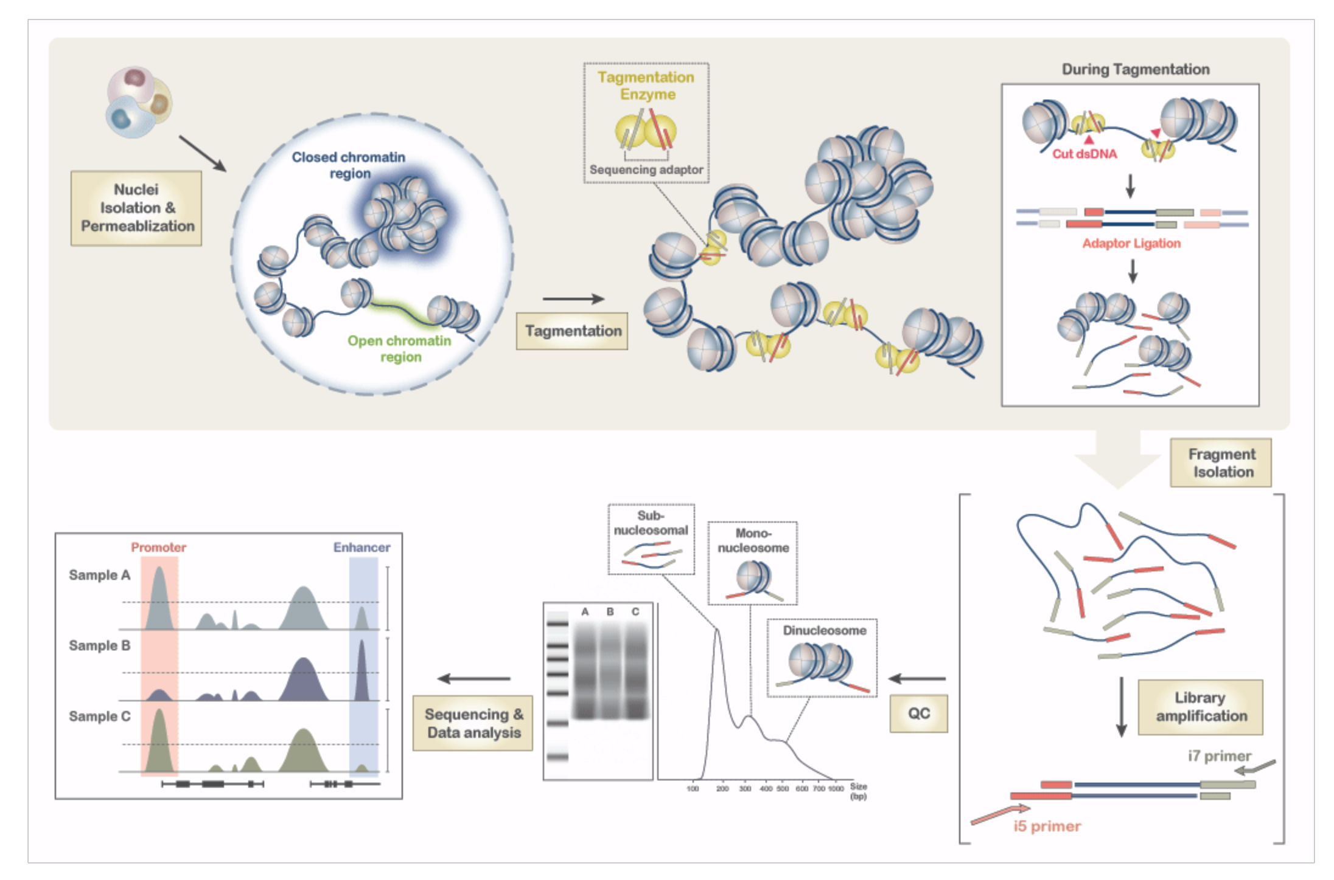
Studying “open” chromatin (ATAC-seq)
ATAC = Assay for Transposase Accessible Chromatin
Tn5 transposase
Image credit: Jee Yun Han

Slide 25
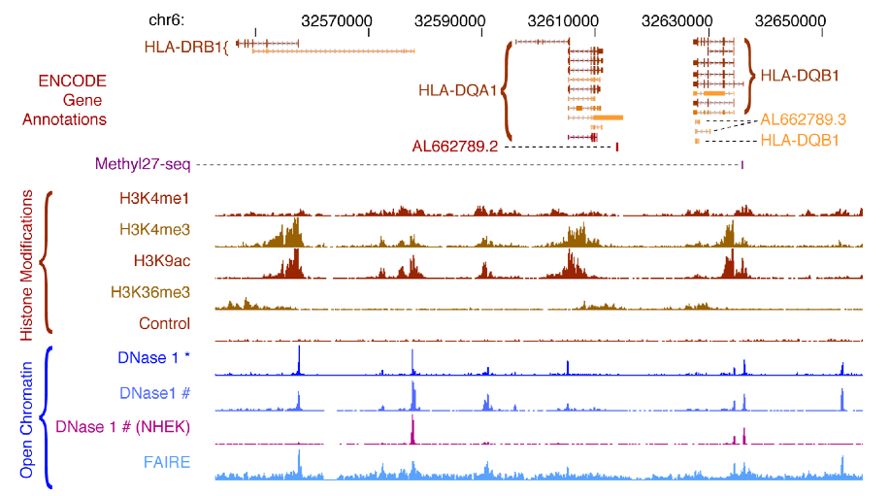
Studying “open” chromatin

Slide 26
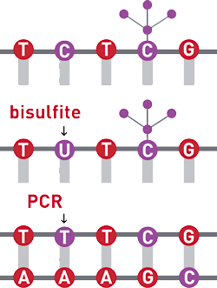
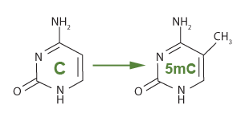
Bisulfite sequencing: DNA Methylation
CH3
5’ -CpG- 3’
3’ -GpC- 5’
CH3
DNA methylation is generally silencing.
Whole Genome Bisulfite Sequencing (WGBS)
5mC
1
0
Methyl-binding protein
TFs
Can also focus on regions of interest by:
Capture sequencing
RRBS
Xie et al., 2013

Slide 27



What about 3D 0rganization of the genome?
~2 Meters!
Enhancer
Promoter
Gene ON
Cancer
Congenital Malformations
Oncogene OFF
Gene OFF
Normal
Normal
3D Genome Organization is Integral to Genome Function!
Oncogene ON
Gene ON
Pathogenic
Methylation or
Microdeletions
Pathogenic
Rearrangements
Flavahan et al. Nature. 2015;
Hnisz et al. Science. 2016
Lupiáñez et al. Cell. 2015;
Franke et al., Nature. 2016

Slide 28
Using Proximity Ligation to Assay 3D Genome Organization
Dekker et al., Science.2002
Figures adapted from:
Rao et al., Cell. 2014
Gorkin et al. Cell Stem Cell 2013

Slide 29
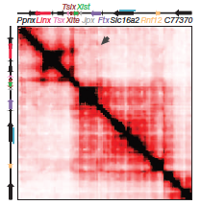
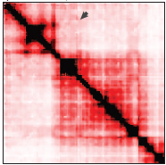
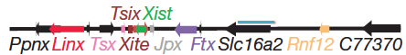
Hi-C: HTS method to study 3D Genome Organization
Hi-C
High throughput Chromatin Conformation Capture
Enhancer
Promoter
Gene ON
Hi-C
Interaction Frequency
Lieberman-Aiden, et al. Science. 2009, Rao et al. Cell. 2014
High
Low
…
…
R1
R2
R3
Rotate
45°
Topologically Associating Domains (TADs)
Nora et al. Nature. 2012
Dixon et al. Nature. 2012

Slide 30
Outline & objectives for today
Overview of High Throughput Sequencing (HTS) technology
Focused on Illumina (most common)
Intro to the human genome and gene regulation
Function and characteristics of cis-regulatory sequences
Common applications of HTS
WGS, WES, RNA-seq, ChIP-seq, DNase-seq, ATAC-seq, Hi-C, WGBS
Learning objectives: (you should be able to…)
Describe some widely used HTS-based methods
Compare and contrast these HTS-based methods
Identify scenarios in which you want to apply one technology vs another

